Slide 1

PetFinder
張家華 李柏霆 鄭子萱 謝昕庭 許聖謙

Slide 2
Problems
EDA
Data Pre-processing
Methods & Evaluation
Model Tunning
Recommendations
Outline

Slide 3
Problems
1

Slide 4

Problem
Adoption efficiency of stray pets
Strategy
Predict adoption speed
Improve adoption rate.
Assist in the allocation of shelter resources.
Solve the problem of excessive stray pets in shelters.
Goal
Notes:
這個專案->流浪動物領養效率問題
預測領養速度
安樂死已廢除
為了紓解收容所動物密度，各地方政府轉而採取「精準捕捉」原則，並且想方設法提高認養率。

Slide 5
Statistical Learning Goal
Data Description
Methods
Predicting the probability of AdoptionSpeed
Classification
Supervised Learning
Rows: 14993
Categorical : 18
Numerical : 5
Text: 1
Outcome variable
AdoptionSpeed
Classification
KNN
Logistic regression
Naïve Bayes
Guassian Process
Bagging
Random Forest
XGboost

Slide 6
Explore Data Analysis
2

Slide 7
Data type
Continuous :
Age, Quantity, PhotoAmt, VideoAmt, Fee,
state_gdp, state_population(Derived variable)
Discrete:
Most variables are discrete type.

Slide 8
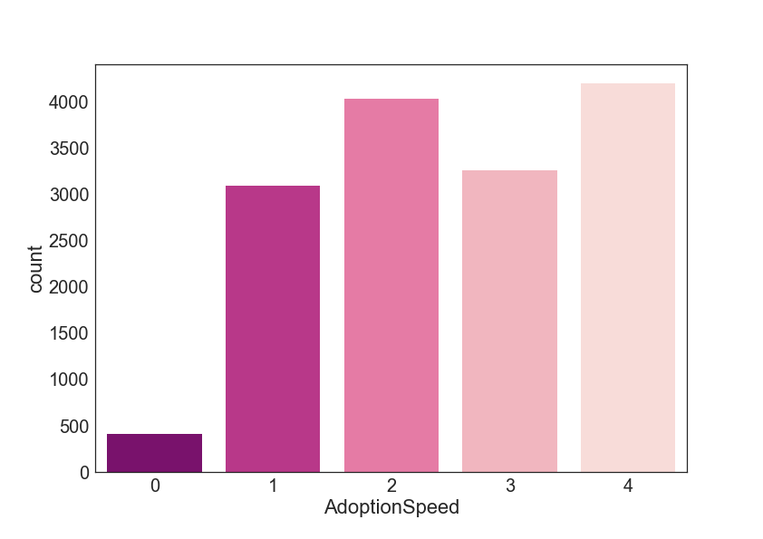
EDA- Adoption Speed
Notes:
流浪動物被領養的速度
為預測目標
數值越低代表越快被領養
0 - Pet was adopted on the same day as it was listed.
1 - Pet was adopted between 1 and 7 days (1st week) after being listed.
2 - Pet was adopted between 8 and 30 days (1st month) after being listed.
3 - Pet was adopted between 31 and 90 days (2nd & 3rd month) after being listed.
4 - No adoption after 100 days of being listed. (There are no pets in this dataset that waited between 90 and 100 days).

Slide 9
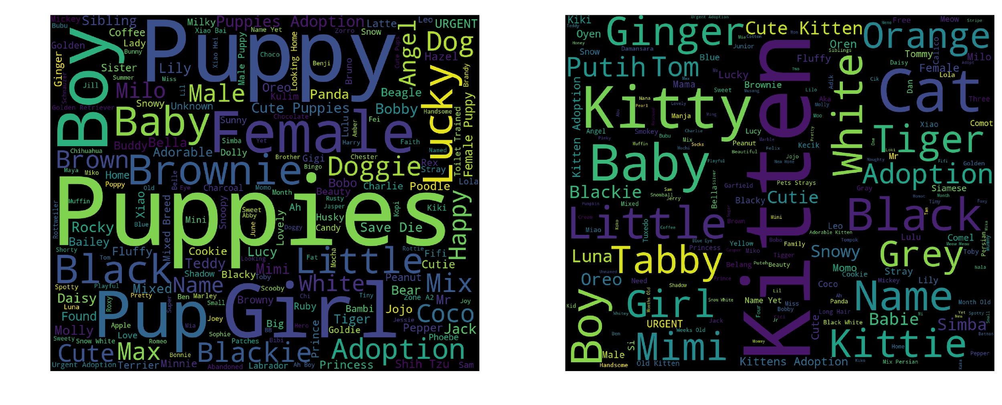
EDA- Name
Dog
Cat

Slide 10
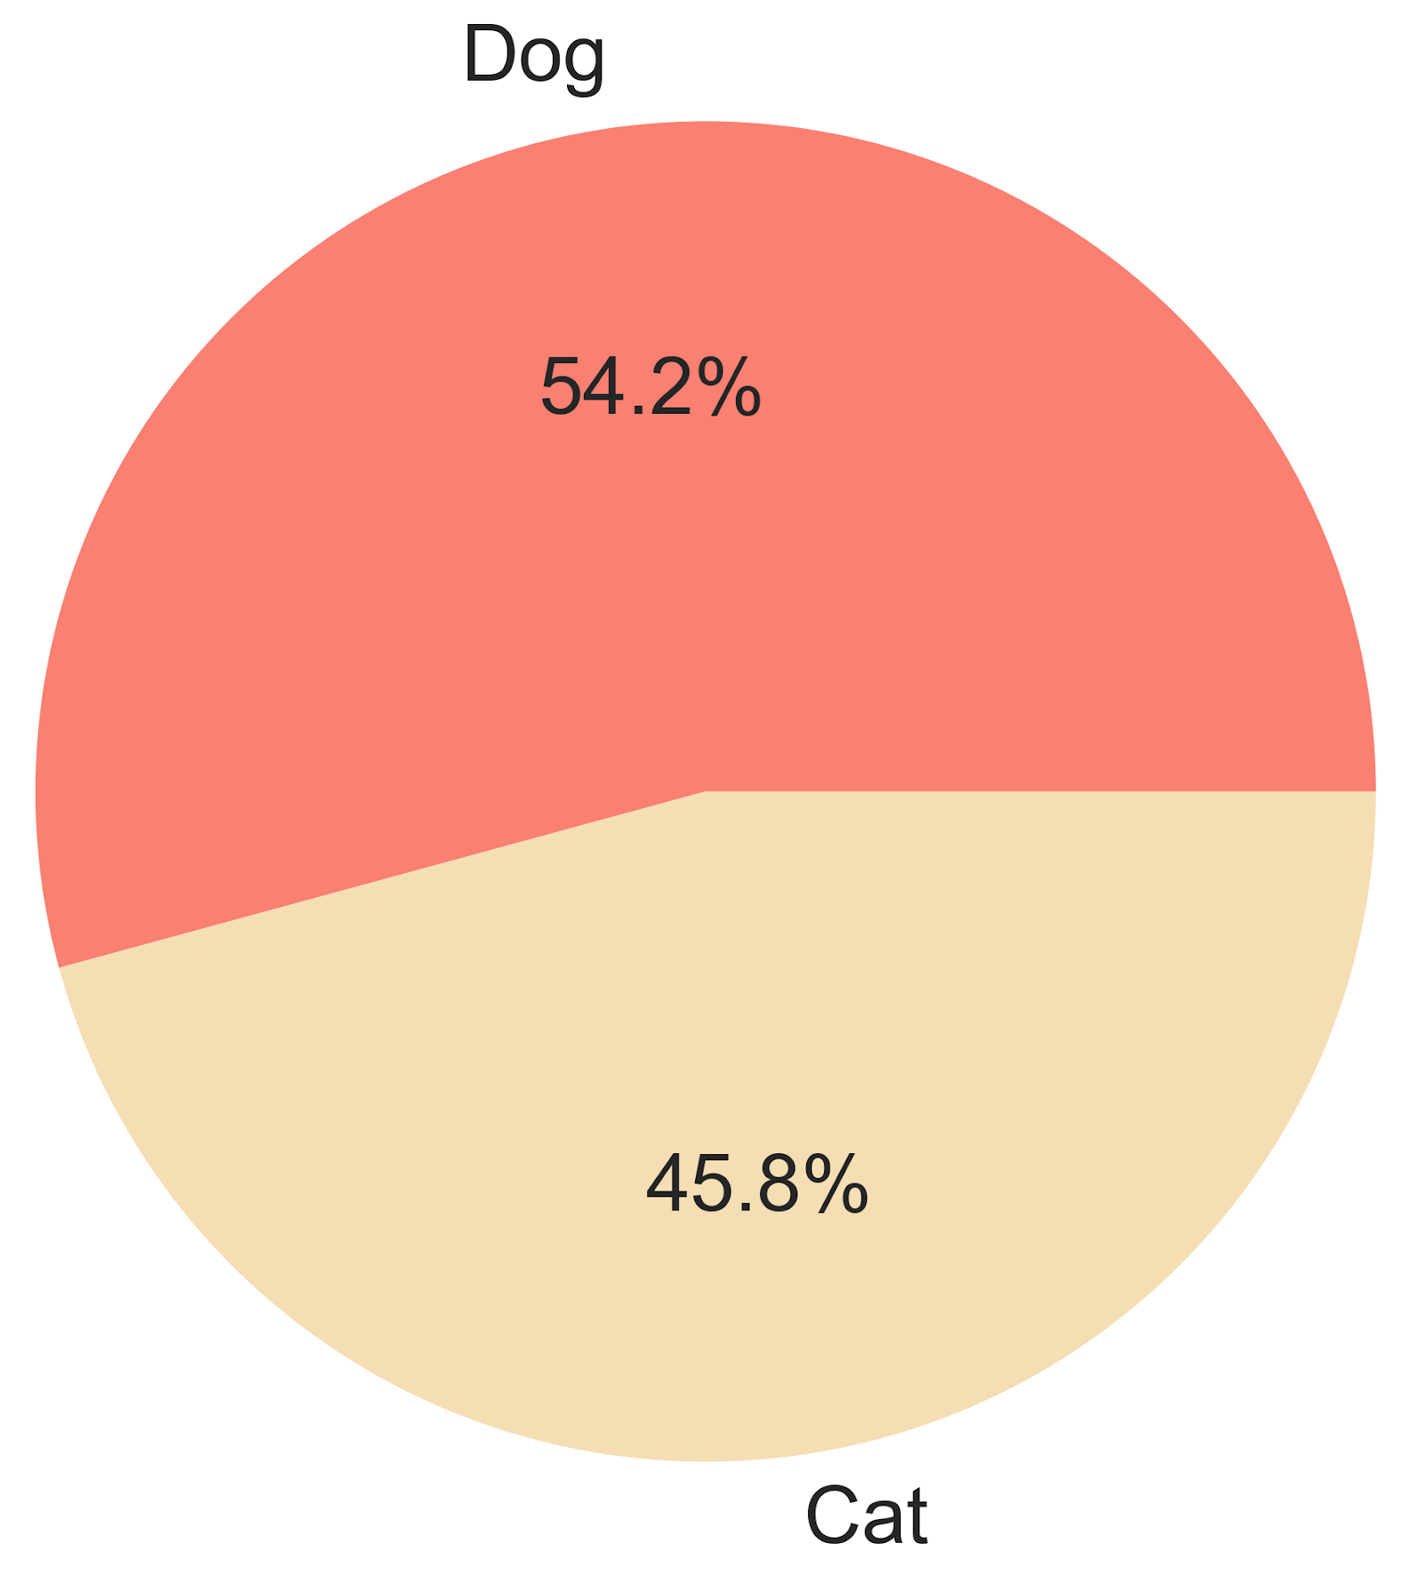
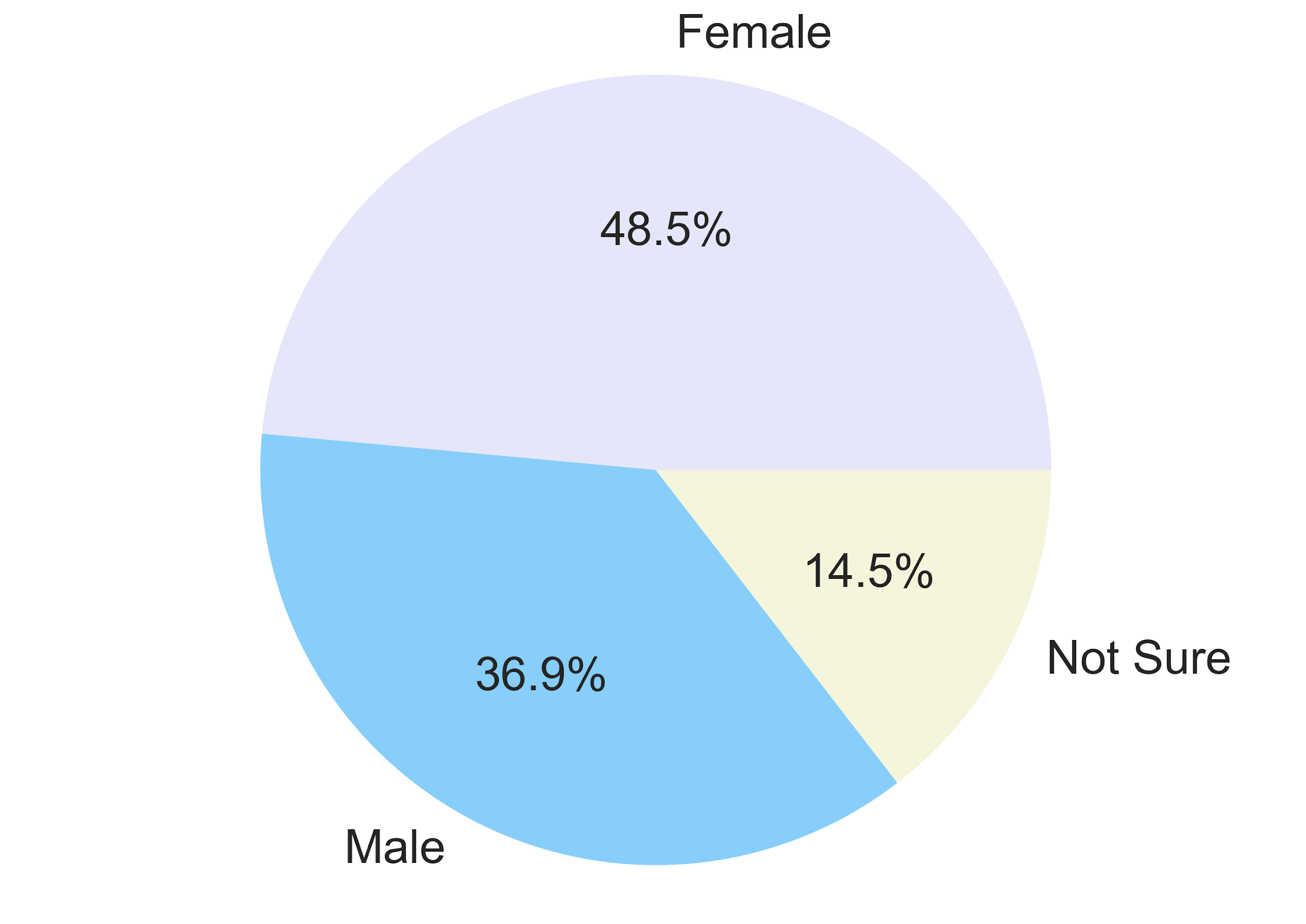
EDA- Type, Gender
Type
Gender
Notes:
Categorical

Slide 11
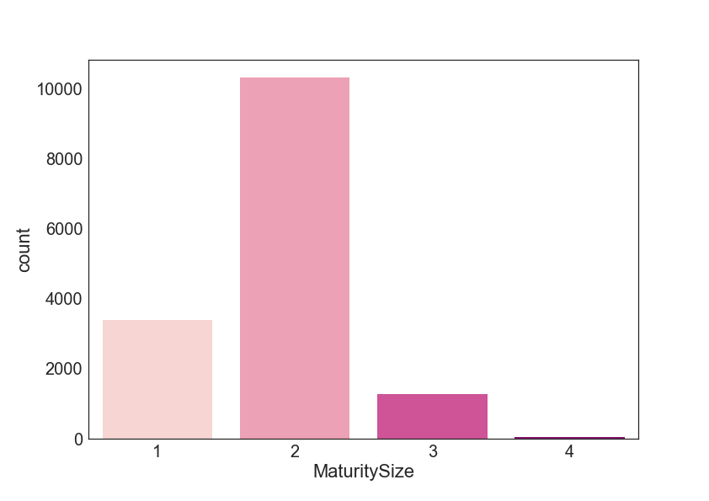
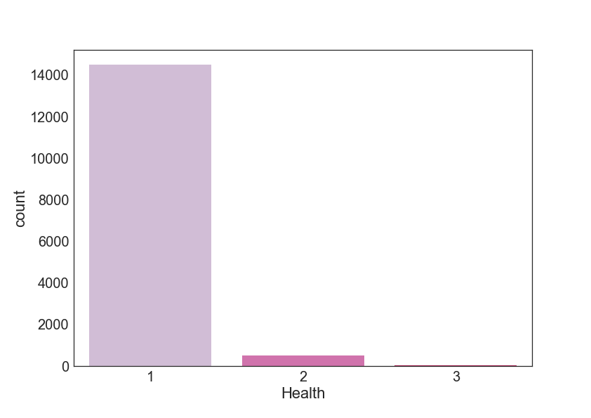
EDA- MaturitySize, Health
Notes:
描述動物健康狀態的Categorical variable
MaturitySize，成熟時的大小 （1 =小，2 =中，3 =大，4 =超大），超大類別的很少
Health，健康狀況 （1 =健康，2 =輕微損傷，3 =嚴重受傷），有受傷的動物很少

Slide 12
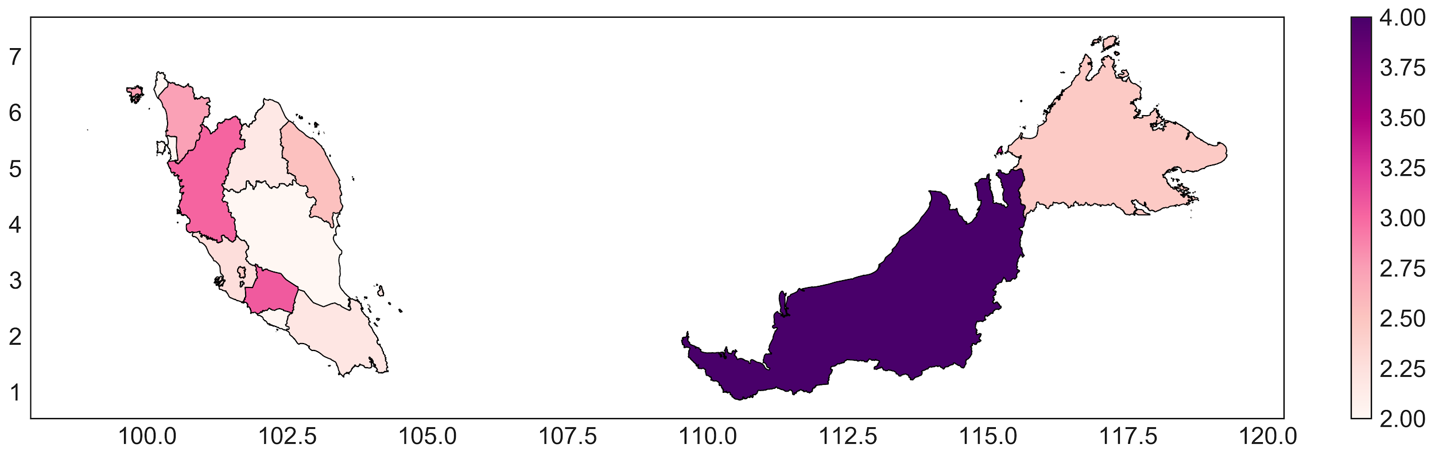
EDA- State
Notes:
每個州平均的adoption speed，顏色越淺代表該州領養的平均值越小。東馬城市化程度較低，領養速度看起來也較慢。

Slide 13
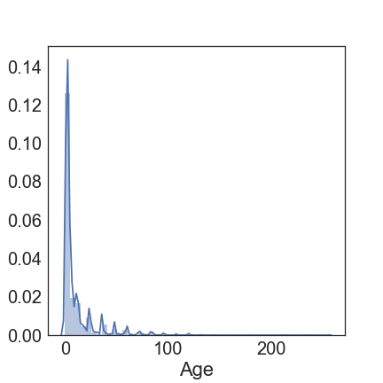
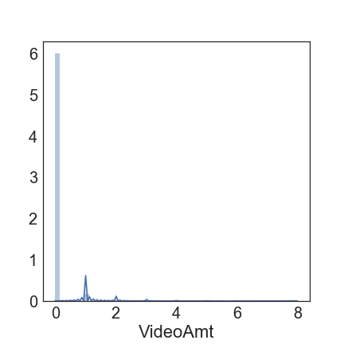
EDA- Age, VideoAmt
Notes:
numerical變數
videoAmt多數都是零張圖片

Slide 14
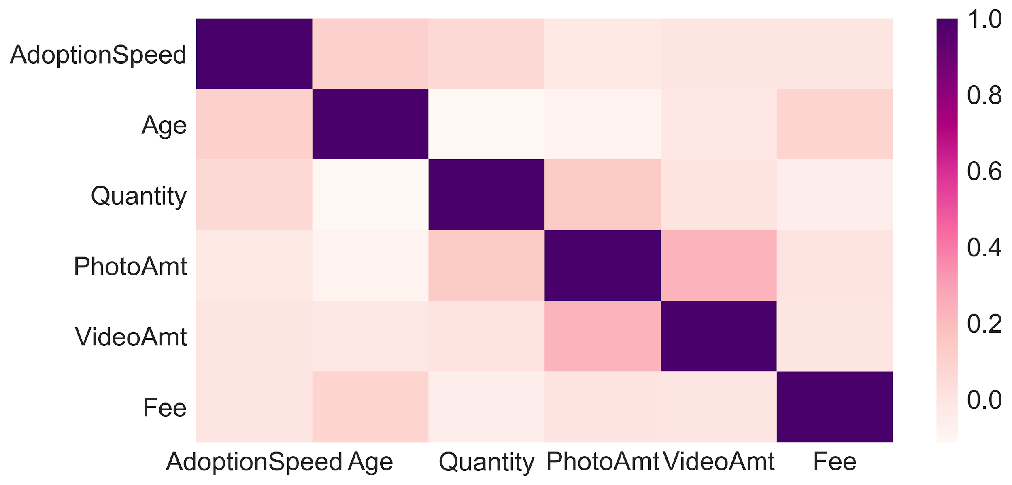
EDA- Correlation
Notes:
numerical variable與y的關聯性圖
Variables do not have high correlation with each other. The highest pairwise correlation is VideoAmt and PhotoAmt.

Slide 15
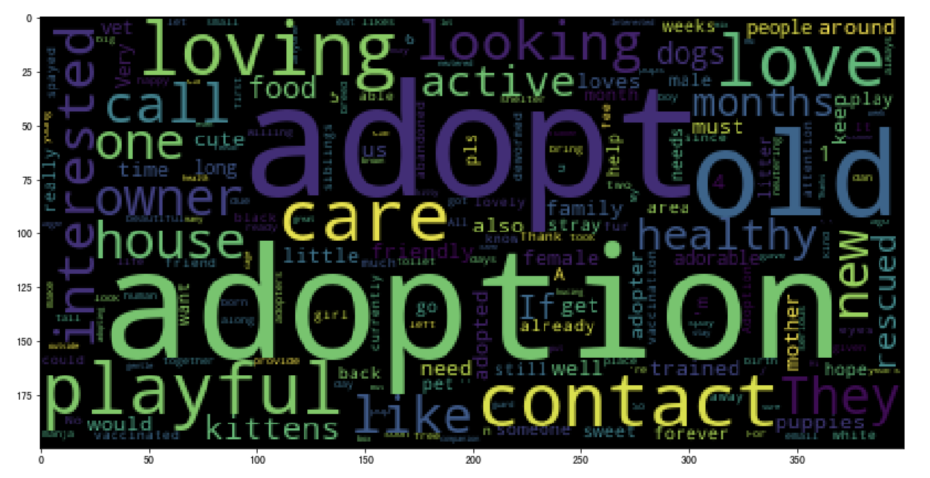
EDA- Description
NLTK未將中文切開，中文詞頻都偏低，不會顯示

Slide 16
Data Pre-processing
3

Slide 17



Categorical & Numerical
Filling Value
Gender: Fill "Not sure" through male to female ratio
Name: Fill missing value with "No Name"
Derived Variables
StateGDP: Map state name to GDP
StatePopulation: Map state name to population
Data Transformation
MaturitySize, Health: Merge rare type to major type
VideoAmt: Binning
Age: Logarithm
Notes:
Gender
1.Gender原本還有第三類>>>並不合理
2.將第三類用np.nan取代
3.並且用原本的男女比例彌補缺值
Name
先將Name裡面的缺值用No Name來取代，並且分成有名字和沒名字兩類
將原本的州名映射到各州的gdp和人口數量
由於MatureSize,Health有幾類原本很少，因此合併某幾類為1類
video amount 原本很少有超過1的，所以分成兩類(>=1,0)

Slide 18
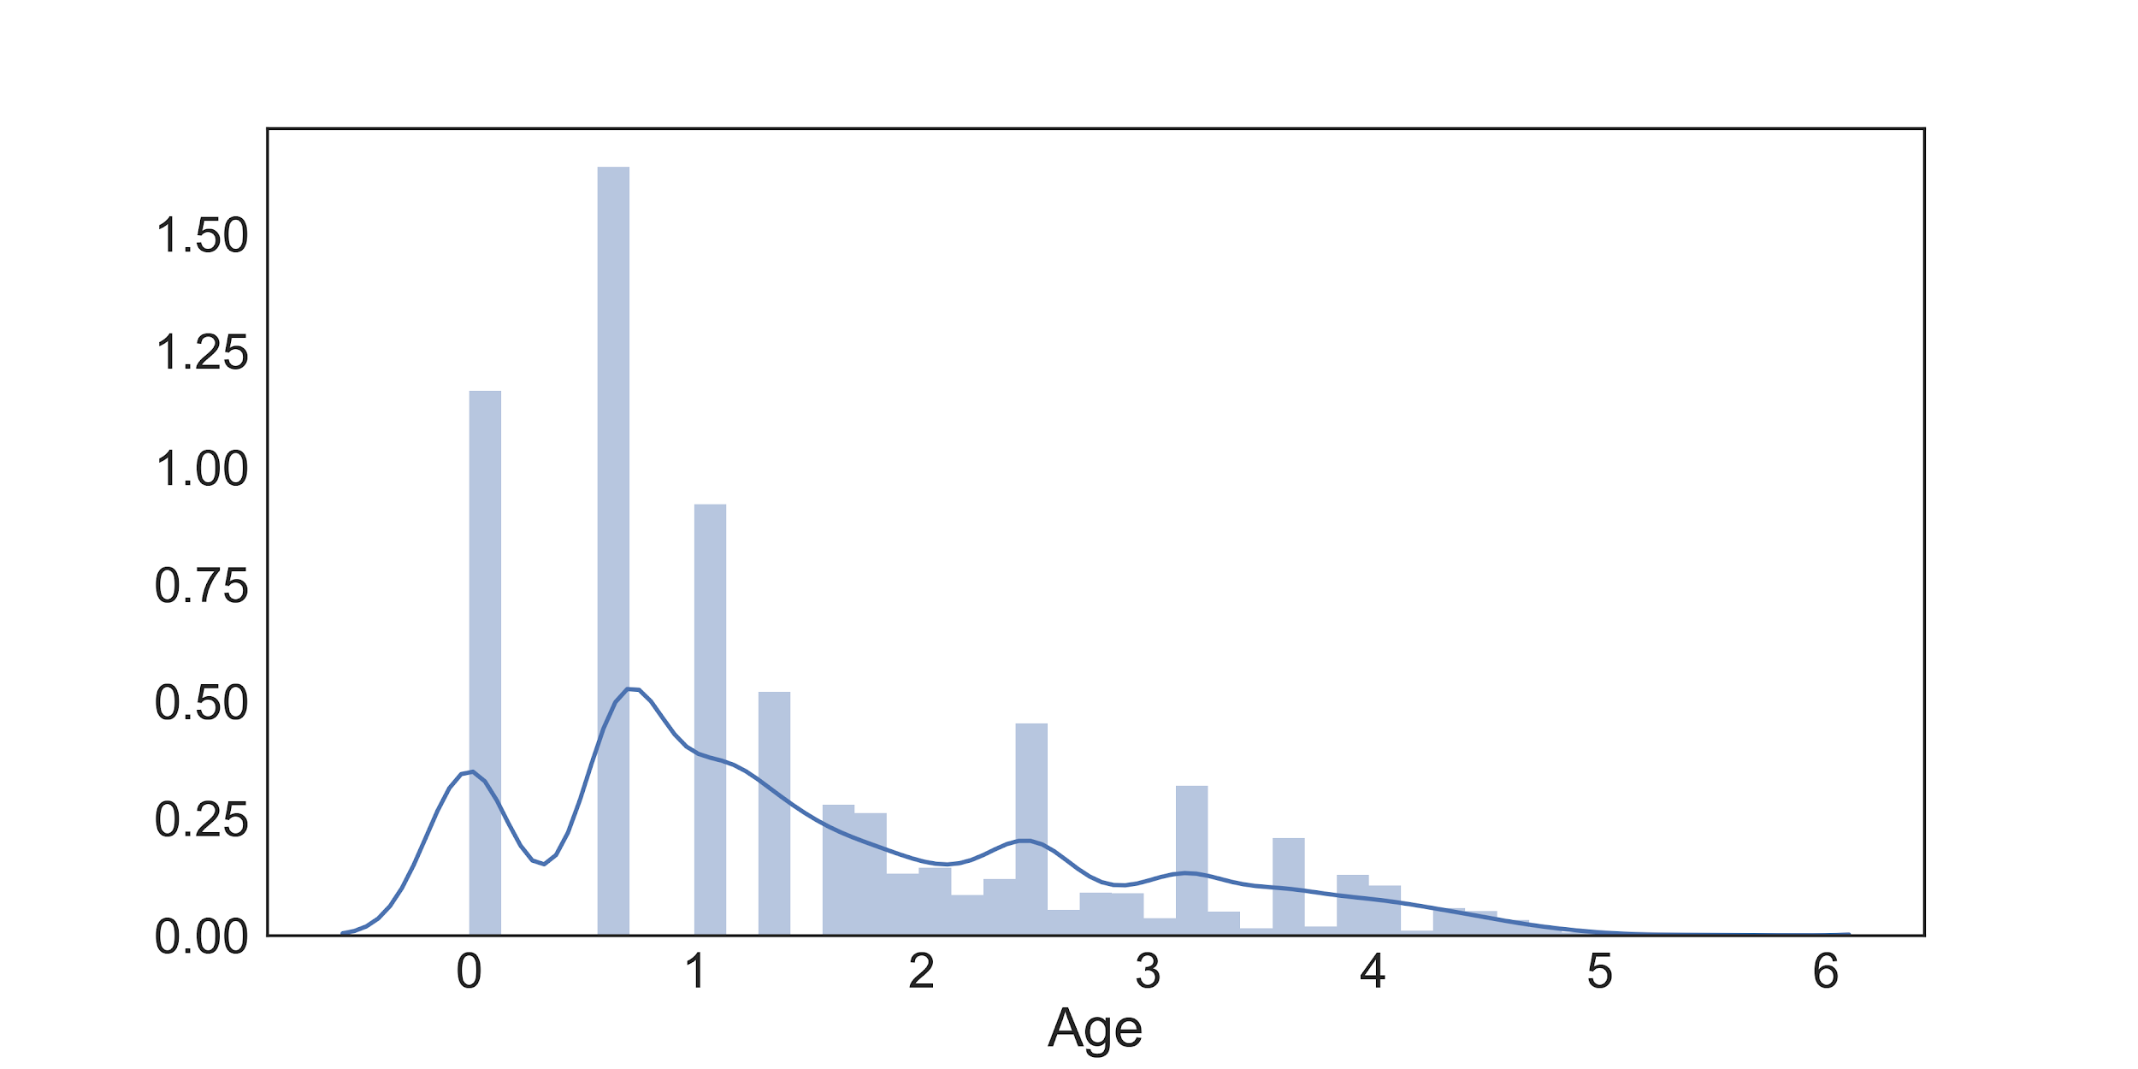
Age

Slide 19
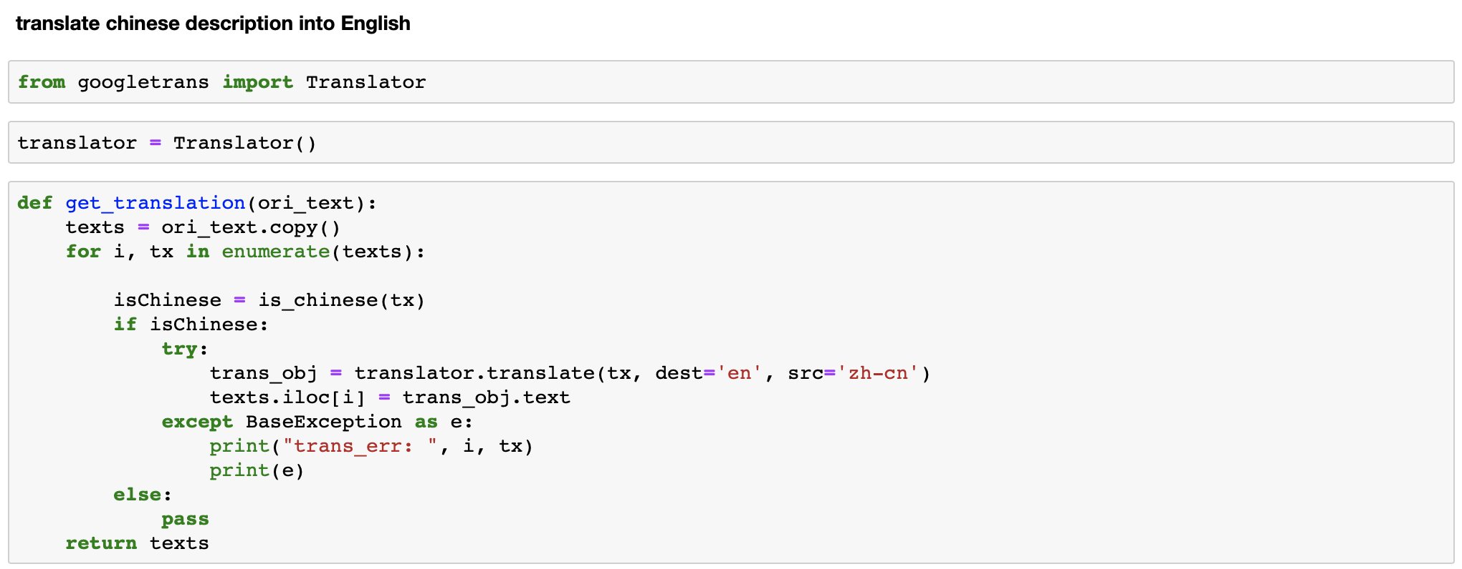
Description
Original data contains English, Chinese, and Malay

Slide 20
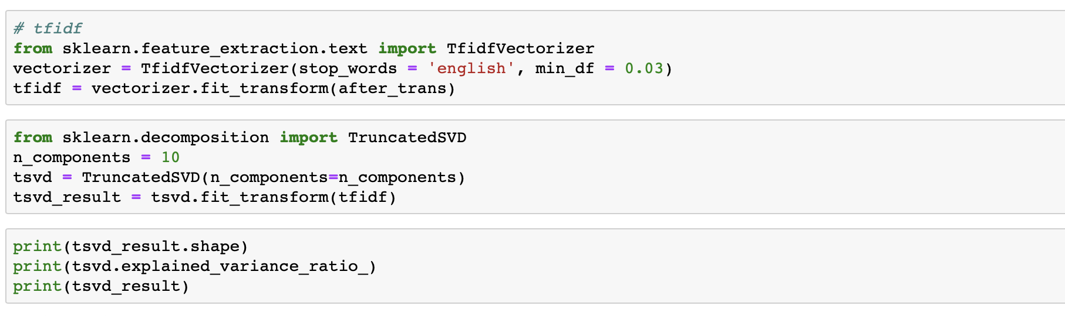
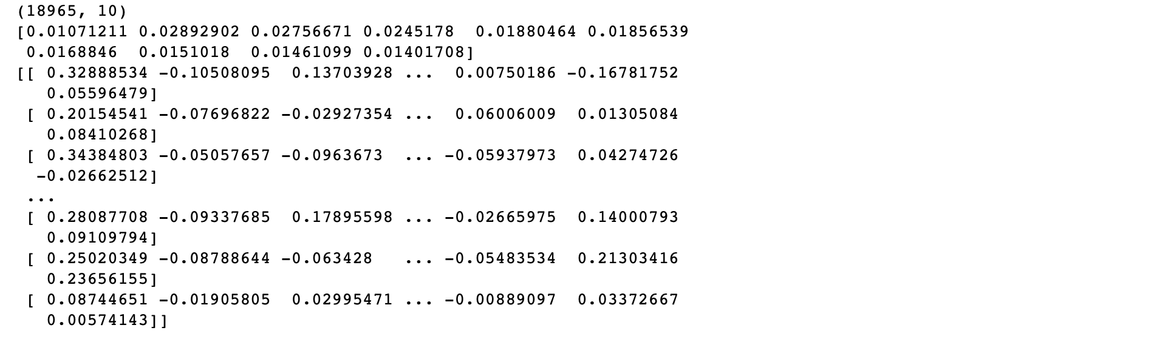
TF-IDF, TruncatedSVD

Slide 21
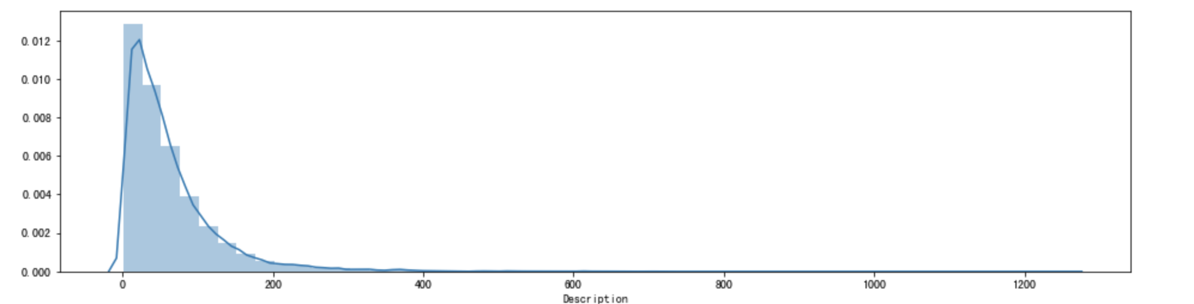
Description Length

Slide 22
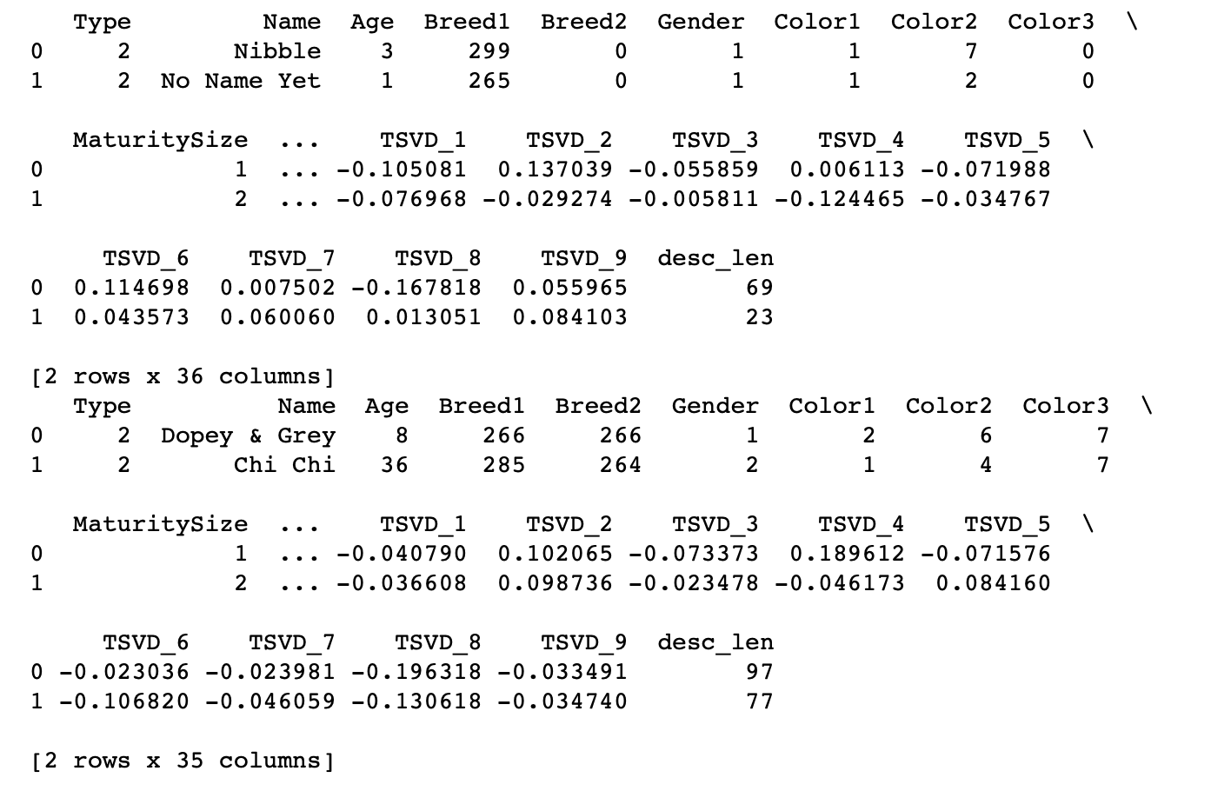
Description Features

Slide 23
Methods &
Evaluation
4

Slide 24
Methods | W/O Description |  | W/ Description
 | Training (75%) | Test (25%) | Training(75%) | Test(25%)
KNN (Benchmark) | 53.82% | 30.83% | 54.03% | 31.34%
Logistic Regression using PyStan | 38.65% | 37.51% | 35.64% | 30.78%
Logistic Regression using Sklearn | 41.3% | 38.8% | 42.9% | 39.0%
Naïve Bayes | 35.4% | 36.2% | 36.9% | 36.1%
Gaussian Process | 35.67% ( 6hr) | 35.50% | 31.92% | 31.44%
Bagging | 82.81 % | 39.85% | 99.99% | 43.45%
Random Forest | 78.96% | 40.76% | 99.99% | 46.01%
Xgboost | 60.43% | 40.78% | 60.07% | 42.41%
Notes:
99.99% overfitting

Slide 25
Other Findings & Comparisons
 | Logistic Regression using Pystan | Logistic Regression using Sklearn
Optimization | full Bayesian statistical inference with MCMC sampling | solver : str, {‘newton-cg’, ‘lbfgs’, ‘liblinear’, ‘sag’, ‘saga’}, optional (default=’liblinear’).
Notes:
MCMC (Markov Chain Monte Carlo)的抽樣方法來取得後驗分布

Slide 26
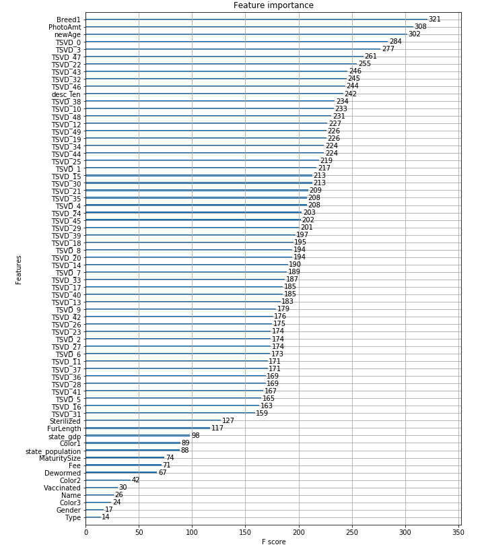
Other Findings & Comparisons - Tree based model
Xgboost
Popular on Kaggle
Based on gradient boosting
Regularization term
Support parallel computation
Feature importance
description feature has high importance
Notes:
Xgboost是kaggle神器，在許多冠軍隊伍中多數都有使用過xgboost。
他是基於gradient boosting的算法，不斷的透過梯度下降，迭代產生新的樹
他在目標函數裡面加了正規化的項目，防止模型overfit。
boosting的算法是基於前面的模型結果來修正後面的模型，是具有順序性的生成樹，因此不像random forest和bagging可以平行處理。在xgboost裡，他一樣是順序性的生成樹，但在生成樹的過程中，將所有feature分到不同的thread去算information gain，來增加運算效率。
我們有看random forest跟xgboost的feature importance plot，發現description經過svd降為的feature佔有蠻高的重要性，代表description的確為決定是否被領養的重要因素

Slide 27
Model Tunning
5

Slide 28
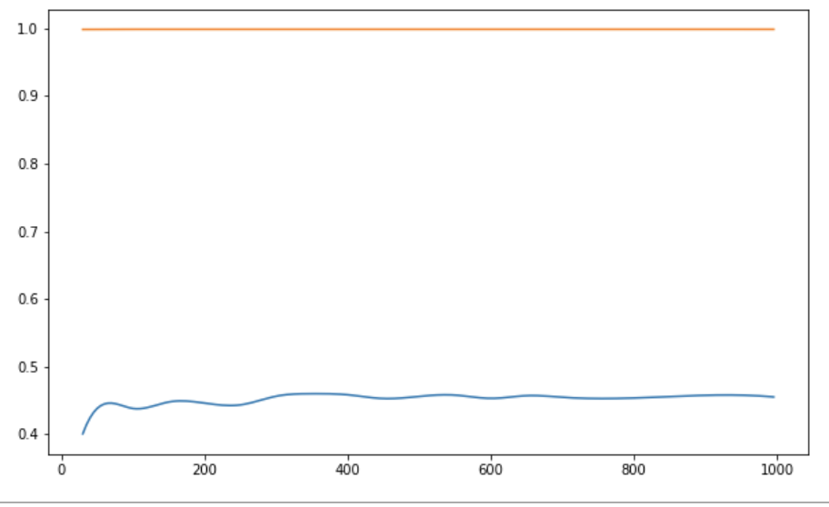
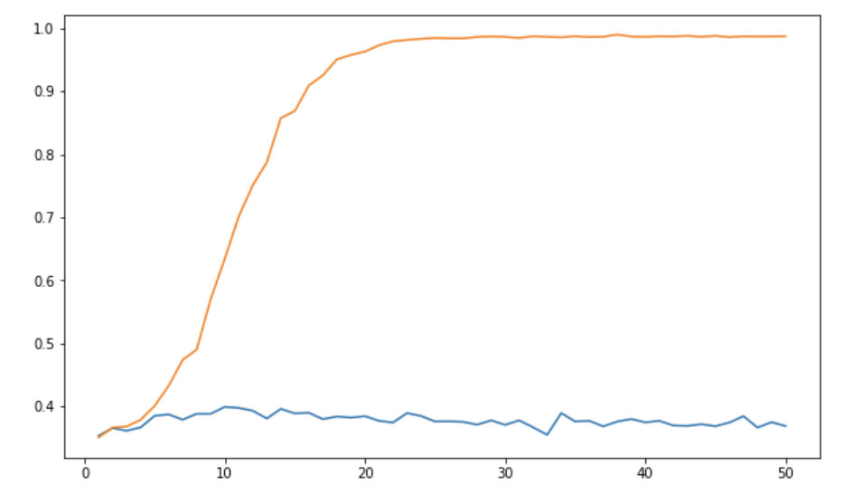
Random Forest
n_estimators
max_depth
Notes:
調整深度：accuracy會下降
x 軸：樹的數量

Slide 29
Recommendations
6

Slide 30
Recommendations
Use K-fold Cross-Validation and get more data to avoid overfitting problem
Implement sentiment analysis on description data
Models might require updates
Build recommendation system based on the model

